Slide 1
Risk Stratification of Patients Using the Lung Cancer Biomarker Panel in China (LCBP)
Final Data Announcement
Chunxue Bai
CAALC

Slide 2
Cohort Design Part 1
5 centers
741 cases
23 cases r/o
CT
Blood test
Non Pro-CA
306
Pro-CA
455
High Risk Model
CT f/u
Bx/Sx
Nodule Model
VS.
ACCP Model
20 cases Metastasis
Non CA
424
CA
317

Slide 3
NODULE MODEL Compare with ACCP
Model 1

Slide 4
Inclusion Criteria
Clinical valued of high risk nodule
All follow-up biopsy or surgical treatment

Slide 5
Training Phase
3 centers, 163 nodules
Parameter estimate and OR for cancer/noncancer trainning set 1(exc center 1 and 5)
Parameter | DF | Estimate | Standard Error | Wald Chi-Square | Pr > Chi-Square | Odds Ratio Estimate | Lower 95% Confidence Limit for Odds Ratio | Upper 95% Confidence Limit for Odds Ratio
Intercept | 1 | -5.6017 | 1.8005 | 9.6794 | 0.0019 | . | . | .
age | 1 | 0.0264 | 0.0275 | 0.9216 | 0.3371 | 1.027 | 0.973 | 1.084
smokec | 1 | 8.8539 | 3.5213 | 6.3221 | 0.0119 | >999.999 | 7.045 | >999.999
diasumm | 1 | 0.1859 | 0.0476 | 15.2874 | <.0001 | 1.204 | 1.097 | 1.322
spiculation | 1 | 3.1865 | 0.8929 | 12.7367 | 0.0004 | 24.204 | 4.206 | 139.284
sexc | 1 | -8.7109 | 3.5556 | 6.002 | 0.0143 | <0.001 | <0.001 | 0.175
Pro_GRP | 1 | -0.00001 | 0.000397 | 0.0007 | 0.9784 | 1 | 0.999 | 1.001
SCC | 1 | 0.0057 | 0.1041 | 0.003 | 0.9563 | 1.006 | 0.82 | 1.233
CYFRA211 | 1 | 0.1686 | 0.0672 | 6.2985 | 0.0121 | 1.184 | 1.038 | 1.35
CEA | 1 | -0.00311 | 0.00158 | 3.8788 | 0.0489 | 0.997 | 0.994 | 1
Probability of malignancy = e^{x}/(1+e^{x})
X=-5.6017+（0.0264 ×age）+（8.8539 ×smoke）+（0.1859 ×diameter）+（3.1865 ×spiculation）+（-8.7109 ×sex）+（-0.00001 ×ProGRP）+（0.0057 ×SCC）+（0.1686 ×CYFRA21-1）+（-0.00311 ×CEA）

Slide 6
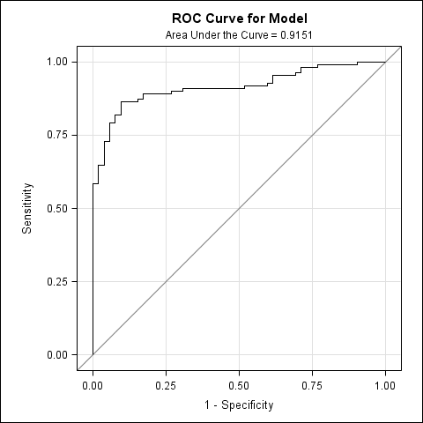
Training Phase
Classification table for cancer/noncancer trainning set 1 (exc center 1 and 5)
Probability Level | Number of Correct Events | Number of Correct Nonevents | Number of Incorrect Events | Number of Incorrect Nonevents | Percentage of Correct Classification | Sensitivity in Percent | Specificity in Percent | Percentage of False Positive | Percentage of False Negative
0.22 | 105 | 13 | 39 | 6 | 72.4 | 94.6 | 25 | 27.1 | 31.6
0.49 | 93 | 42 | 10 | 18 | 82.8 | 83.8 | 80.8 | 9.7 | 30
0.94 | 67 | 49 | 3 | 44 | 71.2 | 60.4 | 94.2 | 4.3 | 47.3
AUC＝0.9151

Slide 7
Validation Phase 1
2 centers, 179 nodules
Classification table for cancer/noncancer validation set 1(inc center 1 and 5)
Probability Level | Correct Events | Correct Nonevents | Incorrect Nonevents | Incorrect Events | Correct Classification | Sensitivity | Specificity
0.22 | 119 | 8 | 32 | 20 | 70.949721 | 85.611511 | 20
0.49 | 111 | 13 | 27 | 28 | 69.273743 | 79.856115 | 32.5
0.94 | 90 | 15 | 25 | 49 | 58.659218 | 64.748201 | 37.5
AUC＝0.5836

Slide 8
Validation Phase 2
5 centers, randomized 126 nodules
Classification table for cancer/noncancer validation set 2(random selected)
Probability Level | Correct Events | Correct Nonevents | Incorrect Nonevents | Incorrect Events | Correct Classification | Sensitivity | Specificity
0.22 | 83 | 9 | 27 | 7 | 73.015873 | 92.222222 | 25
0.49 | 72 | 25 | 11 | 18 | 76.984127 | 80 | 69.444444
0.94 | 59 | 28 | 8 | 31 | 69.047619 | 65.555556 | 77.777778
AUC＝0.7454

Slide 9
LCBP vs. ACCP Model
3 centers, 163 nodules
Probability of malignancy = e^{x}/(1+e^{x})
X=-5.6017+（0.0264 ×age）+（8.8539 ×smoke）+（0.1859 ×diameter）+（3.1865 ×spiculation）+（-8.7109 ×sex）+（-0.00001 ×ProGRP）+（0.0057 ×SCC）+（0.1686 ×CYFRA21-1）+（-0.00311 ×CEA）
LCBP AUC＝0.9151
Probability of malignancy = e^{x}/(1+e^{x})
X=-6.8272+（0.0391 ×age）+（0.7917 ×smoke）+（1.3388×cancer）+（0.1274 ×diameter）+（1.0407 ×spiculation）+（0.7838×location)
ACCP AUC＝0.836

Slide 10
HIGH RISK MODEL
Model 2

Slide 11
Inclusion Criteria
Population with high risk factor of lung cancer
All follow-up at lease 2 year of clinical treatment (include planned CT scan, biopsy or surgical treatment)

Slide 12
Training Phase
3 centers, 240 cases
Parameter estimate and OR for cancer/ben nodule trainning set 1(exc center 1 and 5)
Parameter | DF | Estimate | Standard Error | Wald Chi-Square | Pr > Chi-Square | Odds Ratio Estimate | Lower 95% Confidence Limit for Odds Ratio | Upper 95% Confidence Limit for Odds Ratio
Intercept | 1 | -0.5875 | 1.8445 | 0.1014 | 0.7501 | . | . | .
age | 1 | 0.00848 | 0.0236 | 0.1295 | 0.7189 | 1.009 | 0.963 | 1.056
smokec | 1 | 5.103 | 1.8726 | 7.4259 | 0.0064 | 164.509 | 4.19 | >999.999
diasumm | 1 | 0.1216 | 0.0266 | 20.8309 | <.0001 | 1.129 | 1.072 | 1.19
spiculation | 1 | 3.3835 | 0.6327 | 28.5956 | <.0001 | 29.475 | 8.528 | 101.866
slobec | 1 | -4.0907 | 1.0931 | 14.0045 | 0.0002 | 0.017 | 0.002 | 0.143
ch | 1 | -2.8926 | 6.5255 | 0.1965 | 0.6576 | 0.055 | <0.001 | >999.999
sexc | 1 | -5.1276 | 1.9362 | 7.0136 | 0.0081 | 0.006 | <0.001 | 0.264
Pro_GRP | 1 | -0.00023 | 0.000316 | 0.5388 | 0.4629 | 1 | 0.999 | 1
SCC | 1 | 0.0362 | 0.0733 | 0.2437 | 0.6215 | 1.037 | 0.898 | 1.197
CYFRA211 | 1 | 0.1477 | 0.0535 | 7.6162 | 0.0058 | 1.159 | 1.044 | 1.287
CEA | 1 | -0.00256 | 0.0013 | 3.8533 | 0.0496 | 0.997 | 0.995 | 1
Probability of malignancy = e^{x}/(1+e^{x})
X=-0.5875+（0.00848 ×age）+（5.103 ×smoke）+（-2.8926×cancer）+（0.1216 ×diameter）+（3.3835 ×spiculation）+（-4.0907×location）+（-5.1276 ×cancer）+（-0.00023 ×ProGRP）+（0.0362 ×SCC）+（0.1477 ×CYFRA21-1）+（-0.00256 ×CEA）

Slide 13

Training Phase
Classification table for cancer/ben nodule trainning set 1 (exc center 1 and 5)
Probability Level | Number of Correct Events | Number of Correct Nonevents | Number of Incorrect Events | Number of Incorrect Nonevents | Percentage of Correct Classification | Sensitivity in Percent | Specificity in Percent | Percentage of False Positive | Percentage of False Negative
0.13 | 102 | 63 | 66 | 9 | 68.8 | 91.9 | 48.8 | 39.3 | 12.5
0.55 | 89 | 118 | 11 | 22 | 86.3 | 80.2 | 91.5 | 11 | 15.7
0.68 | 87 | 123 | 6 | 24 | 87.5 | 78.4 | 95.3 | 6.5 | 16.3
AUC＝0.9200

Slide 14
Validation Phase 1
2 centers, 214 cases
Classification table for cancer/ben nodule validation set 1(inc center 1 and 5)
Probability Level | Correct Events | Correct Nonevents | Incorrect Nonevents | Incorrect Events | Correct Classification | Sensitivity | Specificity
0.13 | 125 | 26 | 49 | 14 | 70.560748 | 89.928058 | 34.666667
0.55 | 113 | 34 | 41 | 26 | 68.691589 | 81.294964 | 45.333333
0.68 | 110 | 41 | 34 | 29 | 70.560748 | 79.136691 | 54.666667
AUC＝0.7378

Slide 15
Validation Phase 2
5 centers, randomized 179 nodules
Classification table for cancer/ben nodule validation set 2(random selected)
Probability Level | Correct Events | Correct Nonevents | Incorrect Nonevents | Incorrect Events | Correct Classification | Sensitivity | Specificity
0.13 | 80 | 37 | 52 | 10 | 65.363128 | 88.888889 | 41.573034
0.55 | 74 | 70 | 19 | 16 | 80.446927 | 82.222222 | 78.651685
0.68 | 72 | 72 | 17 | 18 | 80.446927 | 80 | 80.898876
AUC＝0.828

Slide 16
Cohort Design Part 2
5 centers
764 cases
23 cases r/o
BLIND
CT
Blood test
Non Pro-CA
Pro-CA
High Risk Model
CT f/u
Bx/Sx
Nodule Model
VS.
ACCP Model
Non CA
CA

Slide 17
NODULE MODEL
Part 1

Slide 18
Inclusion Criteria
Clinical valued of high risk nodule
All follow-up biopsy or surgical treatment

Slide 19
Training Phase
3 centers, 227 nodules
Parameter estimate and OR for cancer/noncancer trainning set 1(exc center 1 and 5)
Parameter | DF | Estimate | Standard Error | Wald Chi-Square | Pr > Chi-Square | Odds Ratio Estimate | Lower 95% Confidence Limit for Odds Ratio | Upper 95% Confidence Limit for Odds Ratio
Intercept | 1 | -2.7536 | 1.0391 | 7.0229 | 0.008 | . | . | .
age | 1 | 0.0443 | 0.0179 | 6.1431 | 0.0132 | 1.045 | 1.009 | 1.083
smokec | 1 | 1.9305 | 0.927 | 4.3373 | 0.0373 | 6.893 | 1.12 | 42.406
sexc | 1 | -1.5188 | 0.9333 | 2.648 | 0.1037 | 0.219 | 0.035 | 1.364
Pro_GRP | 1 | 0.000097 | 0.000291 | 0.111 | 0.739 | 1 | 1 | 1.001
SCC | 1 | 0.0103 | 0.0876 | 0.0139 | 0.9061 | 1.01 | 0.851 | 1.2
CYFRA211 | 1 | 0.218 | 0.0747 | 8.527 | 0.0035 | 1.244 | 1.074 | 1.44
CEA | 1 | -0.0014 | 0.00114 | 1.4918 | 0.2219 | 0.999 | 0.996 | 1.001
Probability of malignancy = e^{x}/(1+e^{x})
X=-2.7546+（0.0443 ×age）+（1.9305 ×smoke）+（-1.5188 ×sex）+（0.000097 ×ProGRP）+（0.0103 ×SCC）+（0.218 ×CYFRA21-1）+（-0.00114 ×CEA）

Slide 20
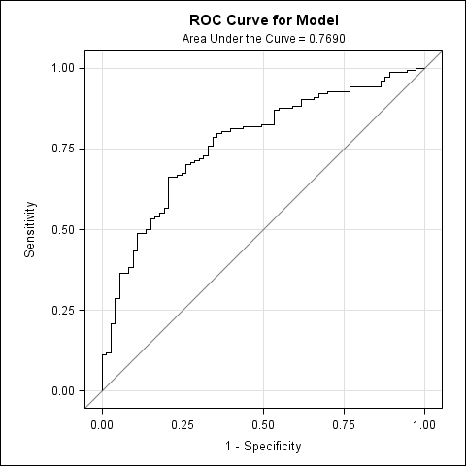
Training Phase
Classification table for cancer/noncancer trainning set 1 (exc center 1 and 5)
Probability Level | Number of Correct Events | Number of Correct Nonevents | Number of Incorrect Events | Number of Incorrect Nonevents | Percentage of Correct Classification | Sensitivity in Percent | Specificity in Percent | Percentage of False Positive | Percentage of False Negative
0.4 | 145 | 8 | 65 | 9 | 67.4 | 94.2 | 11 | 31 | 52.9
0.66 | 102 | 50 | 23 | 52 | 67 | 66.2 | 68.5 | 18.4 | 51
0.91 | 30 | 68 | 5 | 124 | 43.2 | 19.5 | 93.2 | 14.3 | 64.6
AUC＝0.7690

Slide 21
Validation Phase 1
2 centers, 182 nodules
Classification table for cancer/noncancer validation set 1(center 1 and 5)
Probability Level | Correct Events | Correct Nonevents | Incorrect Nonevents | Incorrect Events | Correct Classification | Sensitivity | Specificity
0.4 | 123 | 9 | 33 | 17 | 72.527473 | 87.857143 | 21.428571
0.66 | 87 | 30 | 12 | 53 | 64.285714 | 62.142857 | 71.428571
AUC＝0.7048

Slide 22
Validation Phase 2
5 centers, randomized 151 nodules
Classification table for cancer/noncancer validation set 2(random selected)
Probability Level | Correct Events | Correct Nonevents | Incorrect Nonevents | Incorrect Events | Correct Classification | Sensitivity | Specificity
0.4 | 98 | 6 | 37 | 10 | 68.874172 | 90.740741 | 13.953488
0.66 | 66 | 34 | 9 | 42 | 66.225166 | 61.111111 | 79.069767
0.91 | 17 | 42 | 1 | 91 | 39.072848 | 15.740741 | 97.674419
AUC＝0.7145

Slide 23
HIGH RISK MODEL
Part 1

Slide 24
Inclusion Criteria
Population with high risk factor of lung cancer
All follow-up at lease 2 year of clinical treatment (include planned CT scan, biopsy or surgical treatment)

Slide 25
Training Phase
3 centers, 389 cases
Parameter estimate and OR for cancer/ben nodule trainning set 1(exc center 1 and 5)
Parameter | DF | Estimate | Standard Error | Wald Chi-Square | Pr > Chi-Square | Odds Ratio Estimate | Lower 95% Confidence Limit for Odds Ratio | Upper 95% Confidence Limit for Odds Ratio
Intercept | 1 | -2.9169 | 0.7268 | 16.1062 | <.0001 | . | . | .
age | 1 | 0.03 | 0.0121 | 6.2104 | 0.0127 | 1.03 | 1.006 | 1.055
smokec | 1 | 1.0721 | 0.6451 | 2.7621 | 0.0965 | 2.922 | 0.825 | 10.345
ch | 1 | 0.306 | 0.9369 | 0.1067 | 0.7439 | 1.358 | 0.216 | 8.519
sexc | 1 | -0.7012 | 0.6441 | 1.1852 | 0.2763 | 0.496 | 0.14 | 1.753
Pro_GRP | 1 | 0.000155 | 0.000203 | 0.5825 | 0.4453 | 1 | 1 | 1.001
SCC | 1 | 0.0151 | 0.0522 | 0.0837 | 0.7723 | 1.015 | 0.916 | 1.125
CYFRA211 | 1 | 0.1238 | 0.0318 | 15.1425 | <.0001 | 1.132 | 1.063 | 1.205
CEA | 1 | -0.00043 | 0.000797 | 0.2932 | 0.5882 | 1 | 0.998 | 1.001
Probability of malignancy = e^{x}/(1+e^{x})
X=-2.9169+（0.03 ×age）+（1.0721 ×smoke）+（0.306×cancer）+（-0.7012 ×sex）+（-0.000155 ×ProGRP）+（0.0151 ×SCC）+（0.1238 ×CYFRA21-1）+（-0.00043 ×CEA）

Slide 26
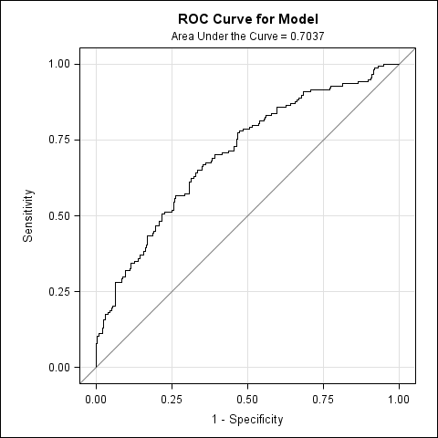
Training Phase
Classification table for cancer/ben nodule trainning set 1 (exc center 1 and 5)
Probability Level | Number of Correct Events | Number of Correct Nonevents | Number of Incorrect Events | Number of Incorrect Nonevents | Percentage of Correct Classification | Sensitivity in Percent | Specificity in Percent | Percentage of False Positive | Percentage of False Negative
0.21 | 145 | 22 | 213 | 9 | 42.9 | 94.2 | 9.4 | 59.5 | 29
0.36 | 101 | 140 | 95 | 53 | 62 | 65.6 | 59.6 | 48.5 | 27.5
0.65 | 23 | 222 | 13 | 131 | 63 | 14.9 | 94.5 | 36.1 | 37.1
AUC＝0.7037

Slide 27
Validation Phase 1
2 centers, 326 cases
Classification table for cancer/ben nodule validation set 1(center 1 and 5)
Probability Level | Correct Events | Correct Nonevents | Incorrect Nonevents | Incorrect Events | Correct Classification | Sensitivity | Specificity
0.21 | 130 | 36 | 150 | 10 | 50.920245 | 92.857143 | 19.354839
0.36 | 87 | 138 | 48 | 53 | 69.018405 | 62.142857 | 74.193548
0.65 | 14 | 185 | 1 | 126 | 61.042945 | 10 | 99.462366
AUC＝0.719

Slide 28
Validation Phase 2
5 centers, randomized 296 nodules
Classification table for cancer/ben nodule validation set 2(random selected)
Probability Level | Correct Events | Correct Nonevents | Incorrect Nonevents | Incorrect Events | Correct Classification | Sensitivity | Specificity
0.21 | 98 | 17 | 163 | 10 | 39.930556 | 90.740741 | 9.4444444
0.36 | 65 | 120 | 60 | 43 | 64.236111 | 60.185185 | 66.666667
0.65 | 14 | 177 | 3 | 94 | 66.319444 | 12.962963 | 98.333333
AUC＝0.6571

Slide 29
Conclusion
 | Marker |  |  | Probability of malignancy
 | Clinical | Biomarker | CT | Low Risk | Middle Risk | High Risk | Accuracy | Sensitivity | Specificity | Max Sensitivity | Max Specificity
Nodule | ✔ |  | ✔ | <5% | 5%-65% | ≥65% | 62.6% | 46.8% | 96.2% | 62.6% | 99.1% | ACCP
 | ✔ | ✔ |  | <4% | 4%-66% | ≥91% | 67.0% | 66.2% | 68.5% | 94.2% | 93.2% | LCBP
 | ✔ | ✔ | ✔ | <22% | 22%-94% | ≥94% | 82.8% | 83.8% | 80.8% | 94.6% | 94.2%
High Risk | ✔ | ✔ |  | <21% | 21%-36% | ≥65% | 62.0% | 65.6% | 59.6% | 94.2% | 94.5%
 | ✔ | ✔ | ✔ | <13% | 13%-68% | ≥68% | 86.3% | 80.2% | 91.5% | 91.9% | 95.3%

Slide 30
Thank You!

